Slide 1
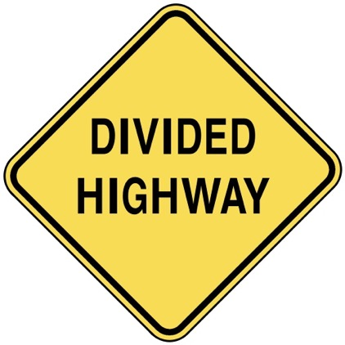
Divided Opinions
JOHN 7
Dr. Rick Griffith • Crossroads International Church Singapore
CICFamily.com & BibleStudyDownloads.org

Slide 2
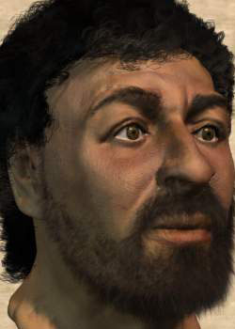
Who is this?

Slide 3
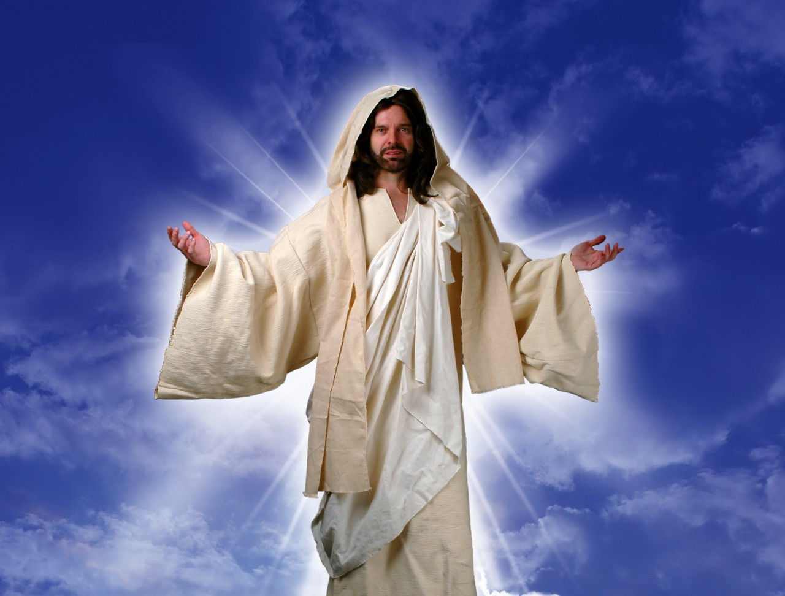
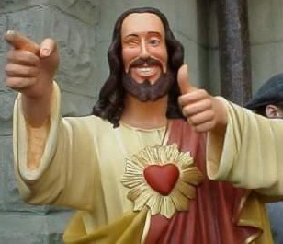
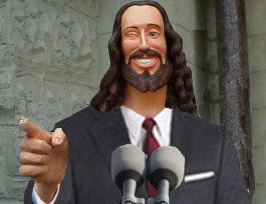
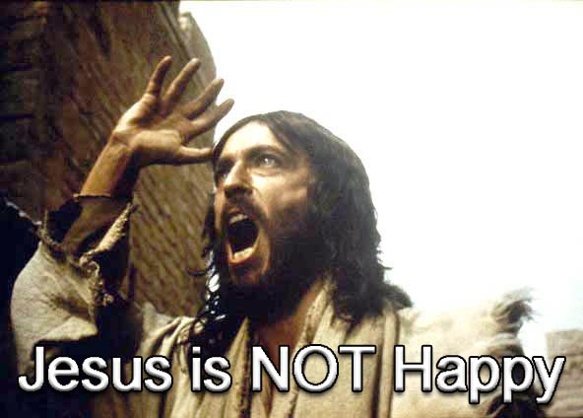
What do you think of Jesus?

Slide 4
Black

Slide 5

Touched by an Angel

Slide 6
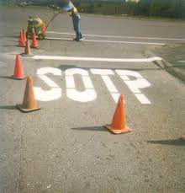
And Christians are considered stupid?!

Slide 7

Four Christmases

Slide 8
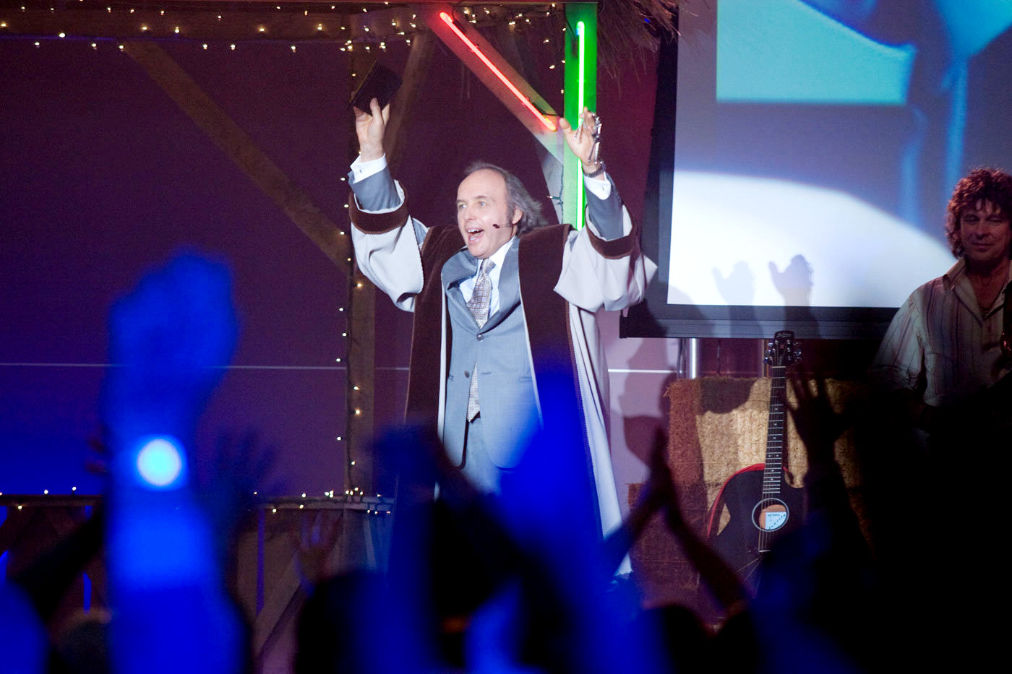
“Four Christmases” Pastor Phil

Slide 9
Black

Slide 10

The Question in John 7
Why do people have such divided opinions about Christ?

Slide 11
A Controversial Figure in John 1–6
Believers in
John 1-4:
Galileans
Samaritan Woman
John the Baptist
Nicodemus
Passover Jews
Disciples
The line of faith
Unbelievers in
John 5–6:
Jerusalem Leaders
Galilean People
Disciples desert Jesus

Slide 12
The Question in John 7
Why do people have such divided opinions about Christ?
3 reasons!

Slide 13
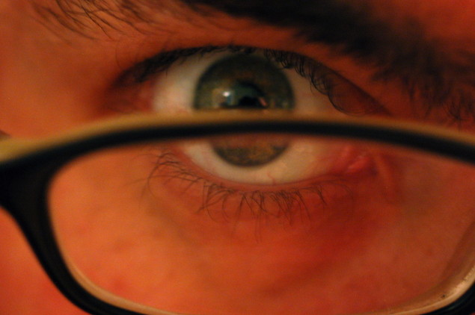
I. Everyone makes his or her own decision about Christ (7:1-13).
Why do people have such divided opinions about Christ?

Slide 14
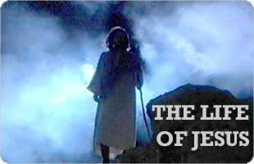
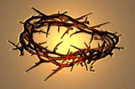
Brothers of Jesus
Transition between Galilean ministry
and Feast of Tabernacles in Jerusalem
“No one who wants to become a public figure acts in secret. Since you are doing these things, show yourself to the world” (7:4).
But when the Jewish Feast of Tabernacles
was near…
(7:2)
My time is not yet come; for you any time is right
...because for me the right time has not yet come.

Slide 15

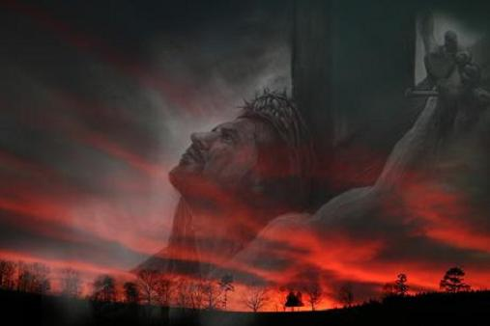
“Hour” in John’s Gospel
NASB Occurrences (Greek are all hora except 7:6, 8):
2:4 “My hour has not yet come”
7:6 “My time (Gr. kairos) is not yet here”
7:8 “My time (Gr. kairos) has not yet fully come”
7:30 “His hour had not yet come”

Slide 16
Black
Notes:
Jerusalem crowds also divided (10-13)

Slide 17
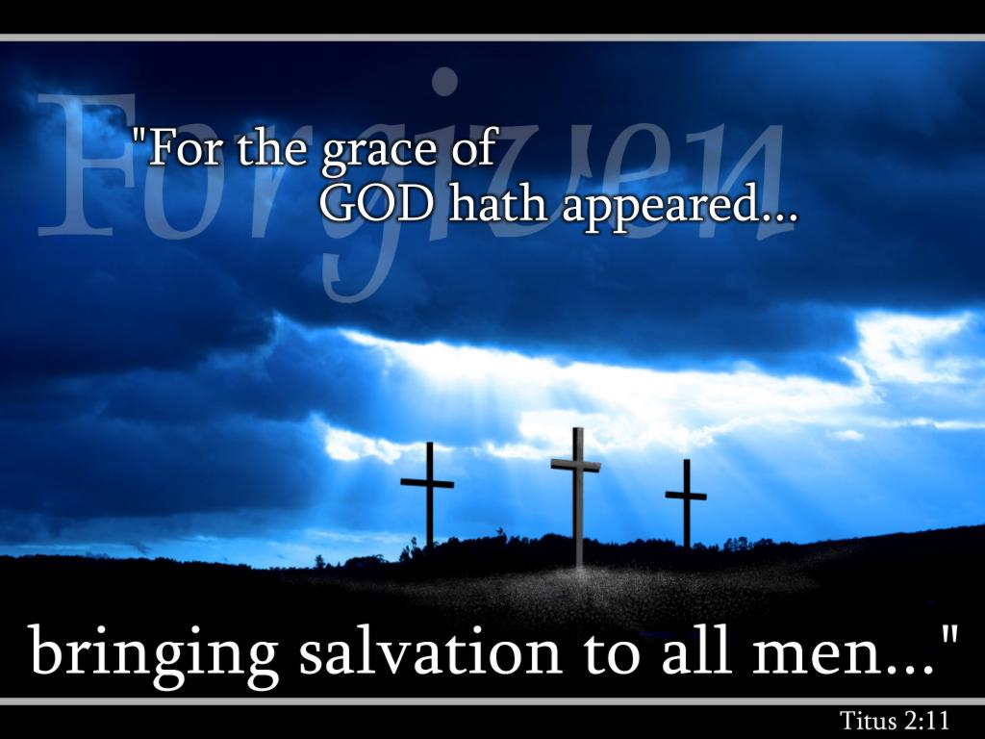
We must each decide who Christ is— and also give that choice to others.

Slide 18
I. Everyone makes his or her own decision about Christ (7:1-13).
Why do people have such divided opinions about Christ?

Slide 19
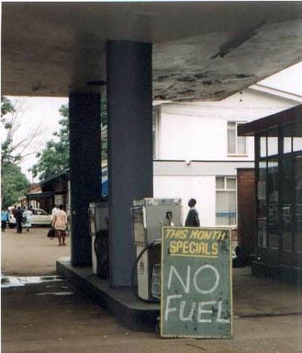

II. People reject Christ’s teaching because they reject God (7:14-36).

Slide 20
Black

Slide 21
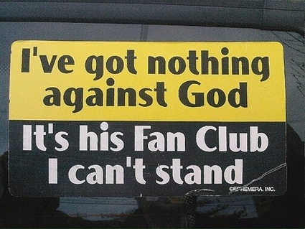
Problems with the Church

Slide 22
I. Everyone makes his or her own decision about Christ (7:1-13).
Why do people have such divided opinions about Christ?

Slide 23
II. People reject Christ’s teaching because they reject God (7:14-36).

Slide 24

III. Jesus’ claim to give eternal life always has a mixed response
(7:37-52).
Why do people have such divided opinions about Christ?

Slide 25
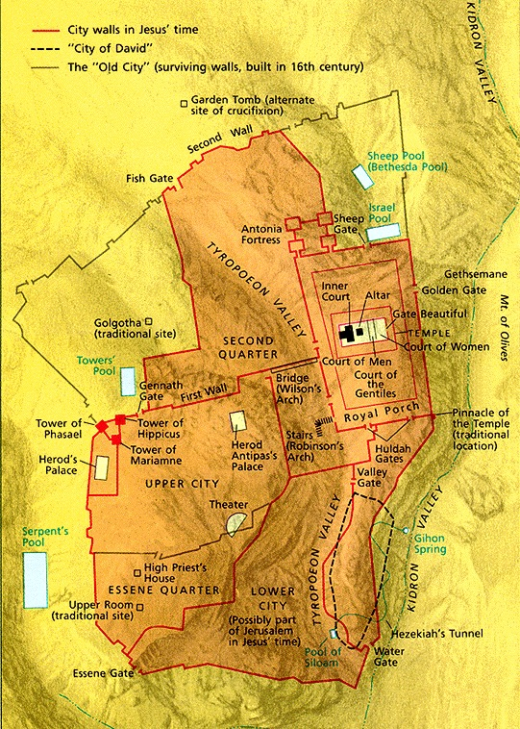
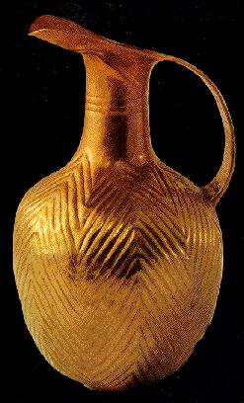
Jerusalem
21
The Feast of Tabernacles

Slide 26
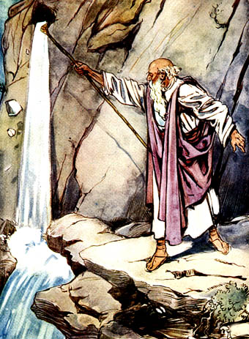
Water from a Rock
Numbers 20:8-11

Slide 27

“Anyone who is thirsty may come to me! ³⁸ Anyone who believes in me may come and drink! For the Scriptures declare, ‘Rivers of living water will flow from his heart.’”
(John 7:37-38 NLT)
Notes:
When Jesus added, As the Scripture has said, He did not identify the Old Testament passage(s) He had in mind. But He may have thought of Psalm 78:15-16 and Zechariah 14:8 (cf. Ezek. 47:1-11; Rev. 22:1-2).
John F. Walvoord, Roy B. Zuck and Dallas Theological Seminary., The Bible Knowledge Commentary : An Exposition of the Scriptures (Wheaton, IL: Victor Books, 1983-c1985), 2:301.

Slide 28
Black

Slide 29

Black

Slide 30

Q & A in John 7
Curious: “Where did he get all this knowledge?” (14-15).
Jesus’ Answer: “God gave it to me.”
Offended: “You’re demon possessed! Who’s trying to kill you?” (20).
Jesus’ Answer: “Hypocrites are who care more for circumcision than for people.”

Slide 31
Q & A in John 7
Uninformed: “Isn’t this the man they are trying to kill? But the Messiah will simply appear…” (25).
Jesus’ Answer: “You know where I’m from—but you don’t know God!”
Believing: “Will the Messiah do more miracles than Jesus?” (31).
Jesus’ Answer: “I will be with you only for a short time more [about 6 months] but you won’t find me and can’t follow me.”

Slide 32
Which are You?
Curious?
Offended?
Uninformed?
Believing?

Slide 33

Main Idea
People reject Christ because they don’t accept God’s authority over their lives.

Slide 34

Jesus Paid It All

Slide 35
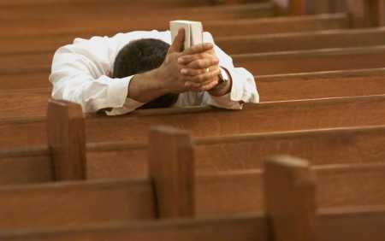
Why not believe today?

Slide 36


NT Preaching link at BibleStudyDownloads.org
Get this presentation and script for free!
Notes:
NT Preaching (np)

